Slide 1

Galactic Navigator
teamName.h
App Developed by:
Eric Chan
Matthew Owney
Zhuohao Yang

Slide 2
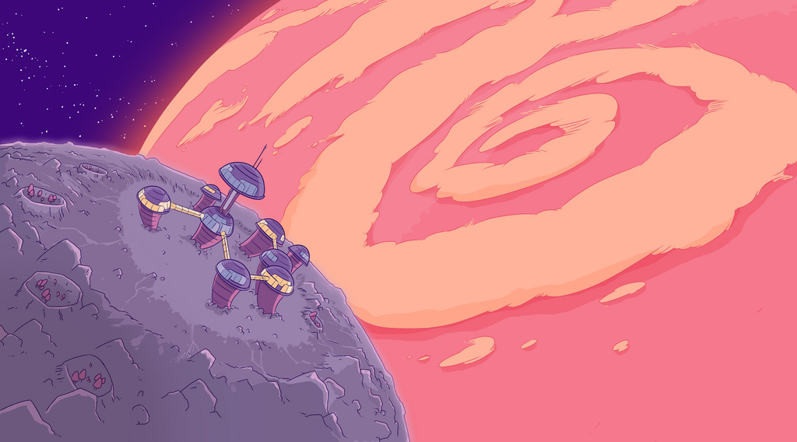
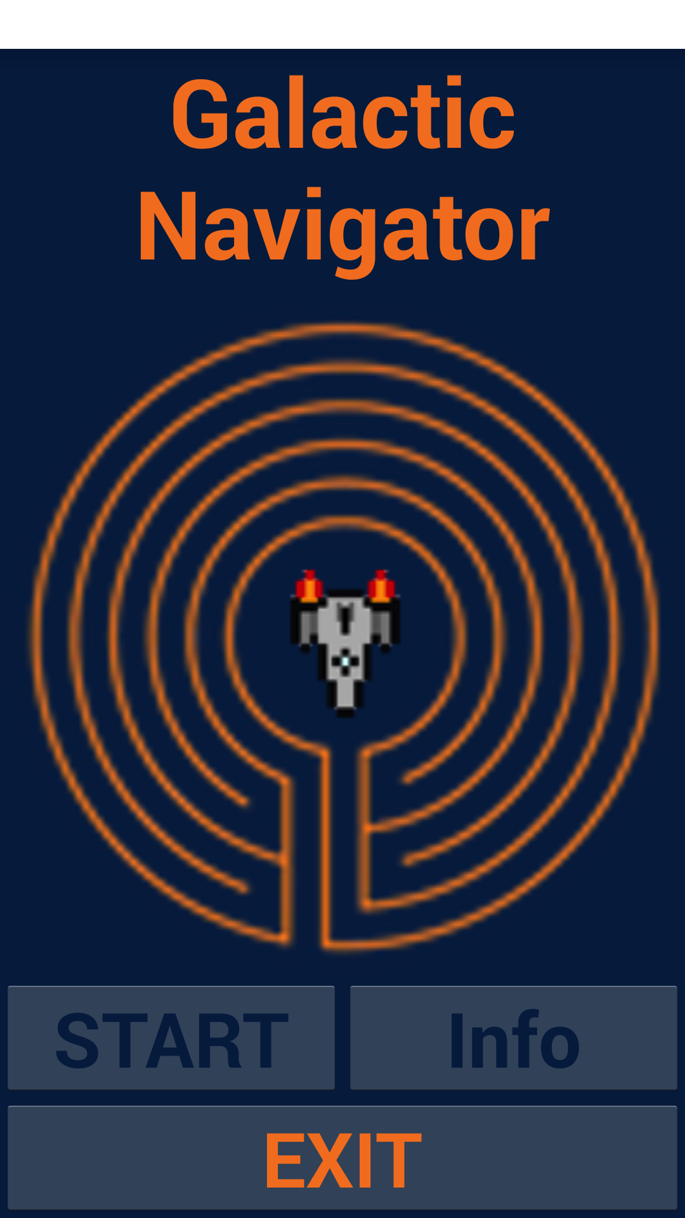
Welcome to the Galactic Navigator
Galactic Navigator is an exciting game where the spaceship must escape destroyed Earth and navigate its way through a space maze to a new planet. On its journey, it will encounter many obstacles, including black holes and system scramblers.

Slide 3

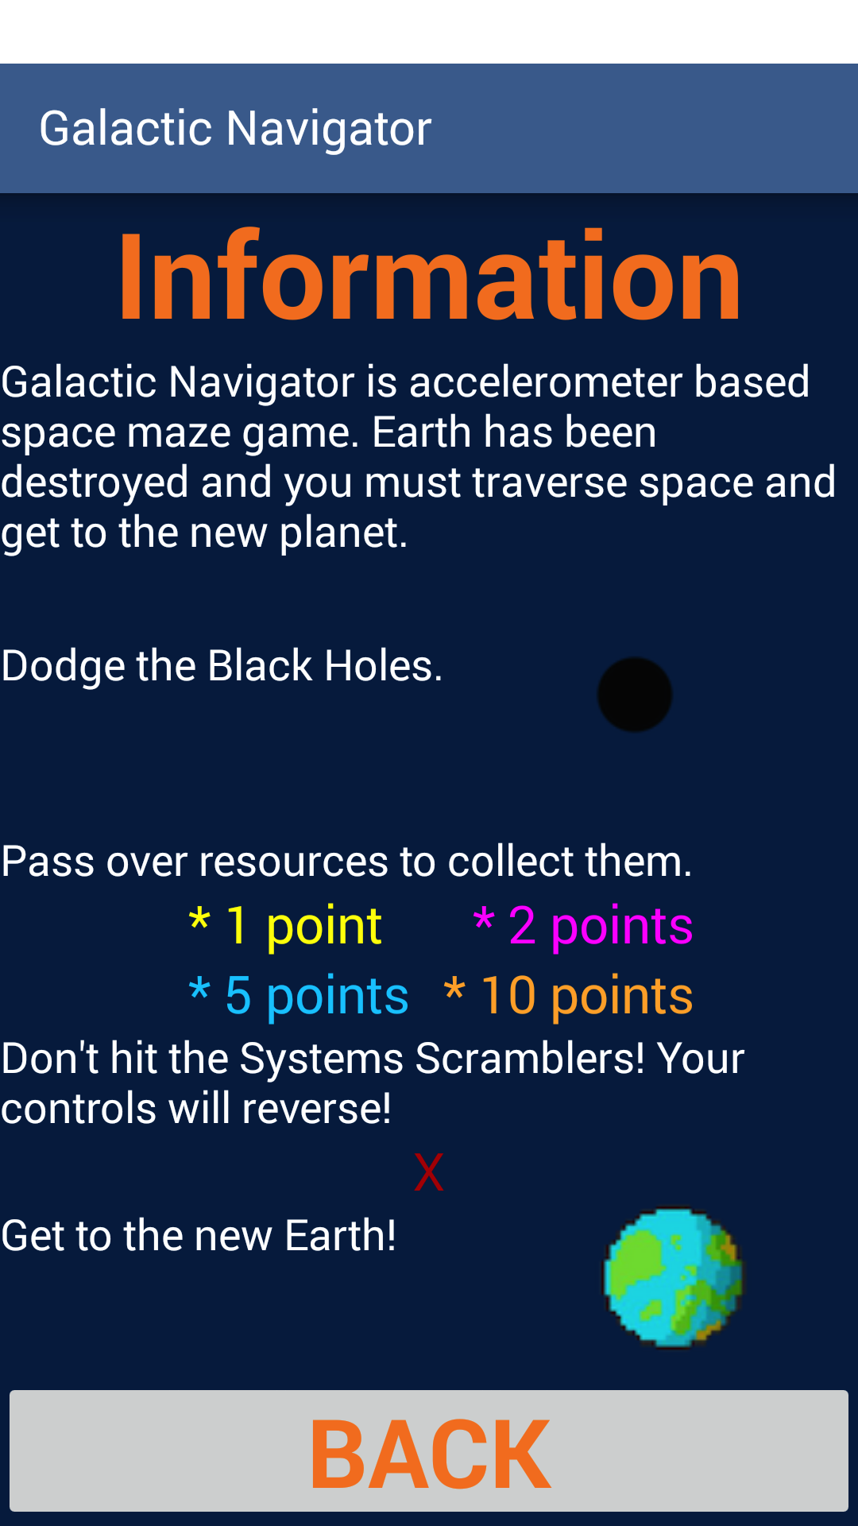
Information Screen
Point of the game is to avoid black holes
Different Resources hold different values. Pass over to collect.
System Scramblers reverse the accelerometer values and reverses all the directions
Goal is to get to the new Earth!

Slide 4

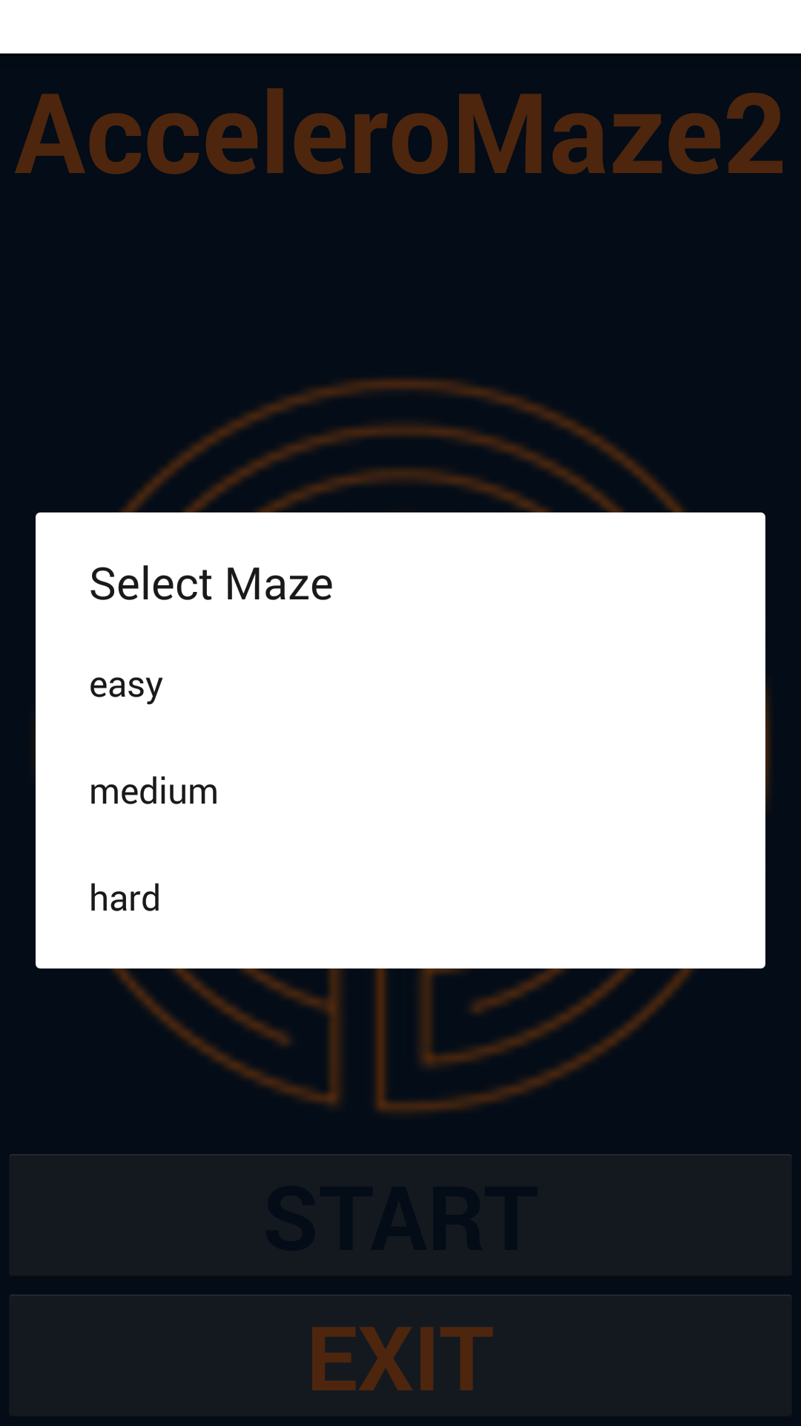
Level Selection Screen
Three difficulty levels to choose. Good luck!

Slide 5

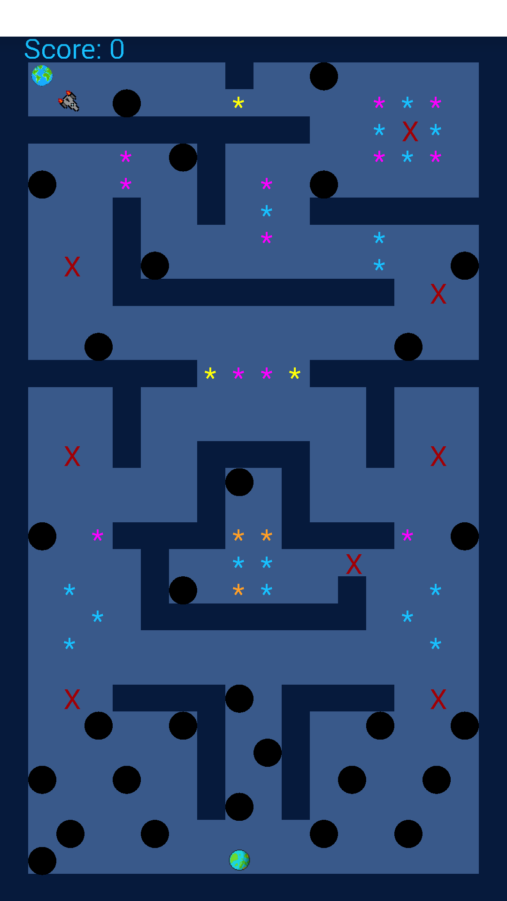
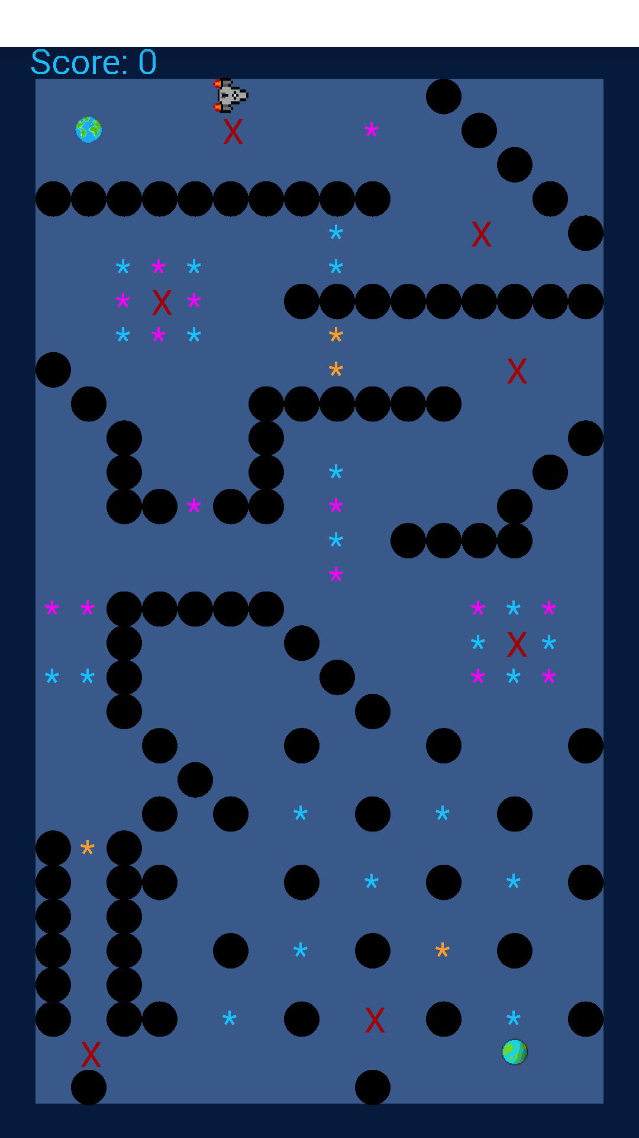
More difficulty levels to choose
More fun to play
Medium
Hard

Slide 6
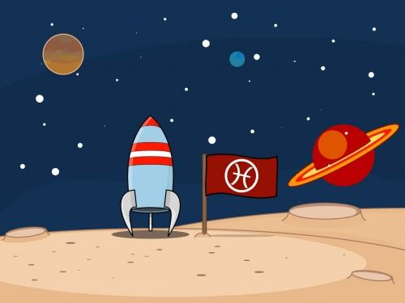
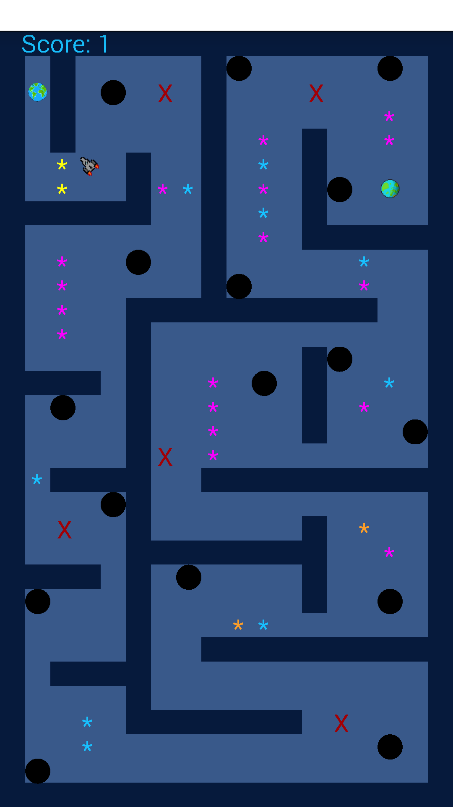
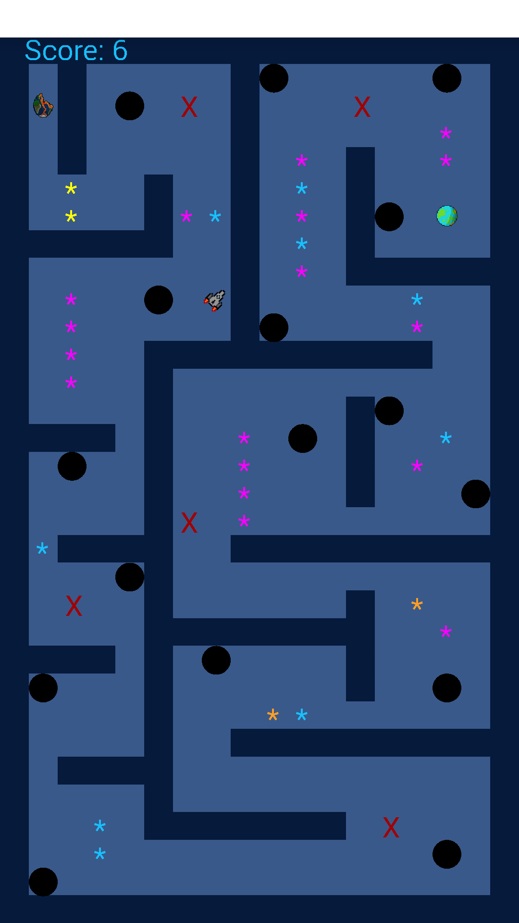
Pass through Power Crystals to get higher score.
Intriguing Features
Gravity inverts when moving through “X”

Slide 7

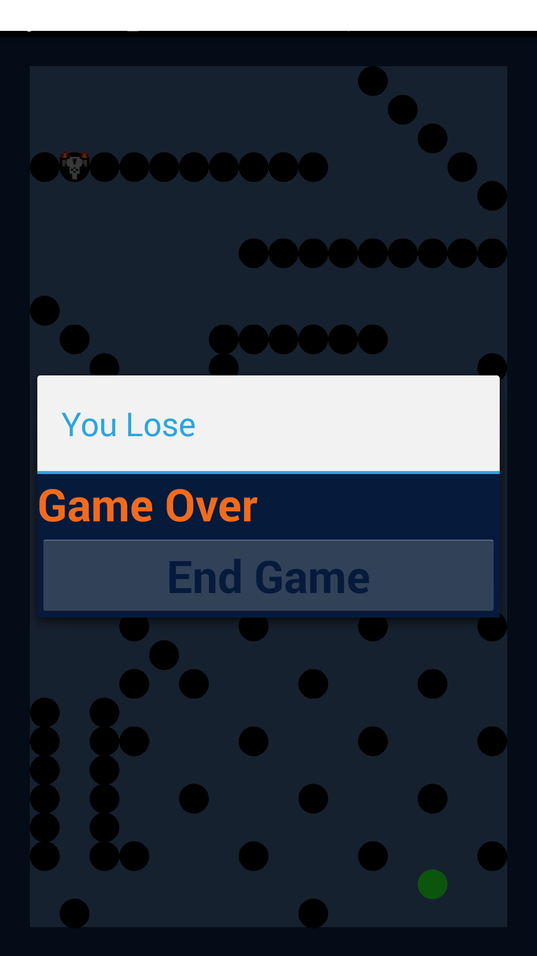
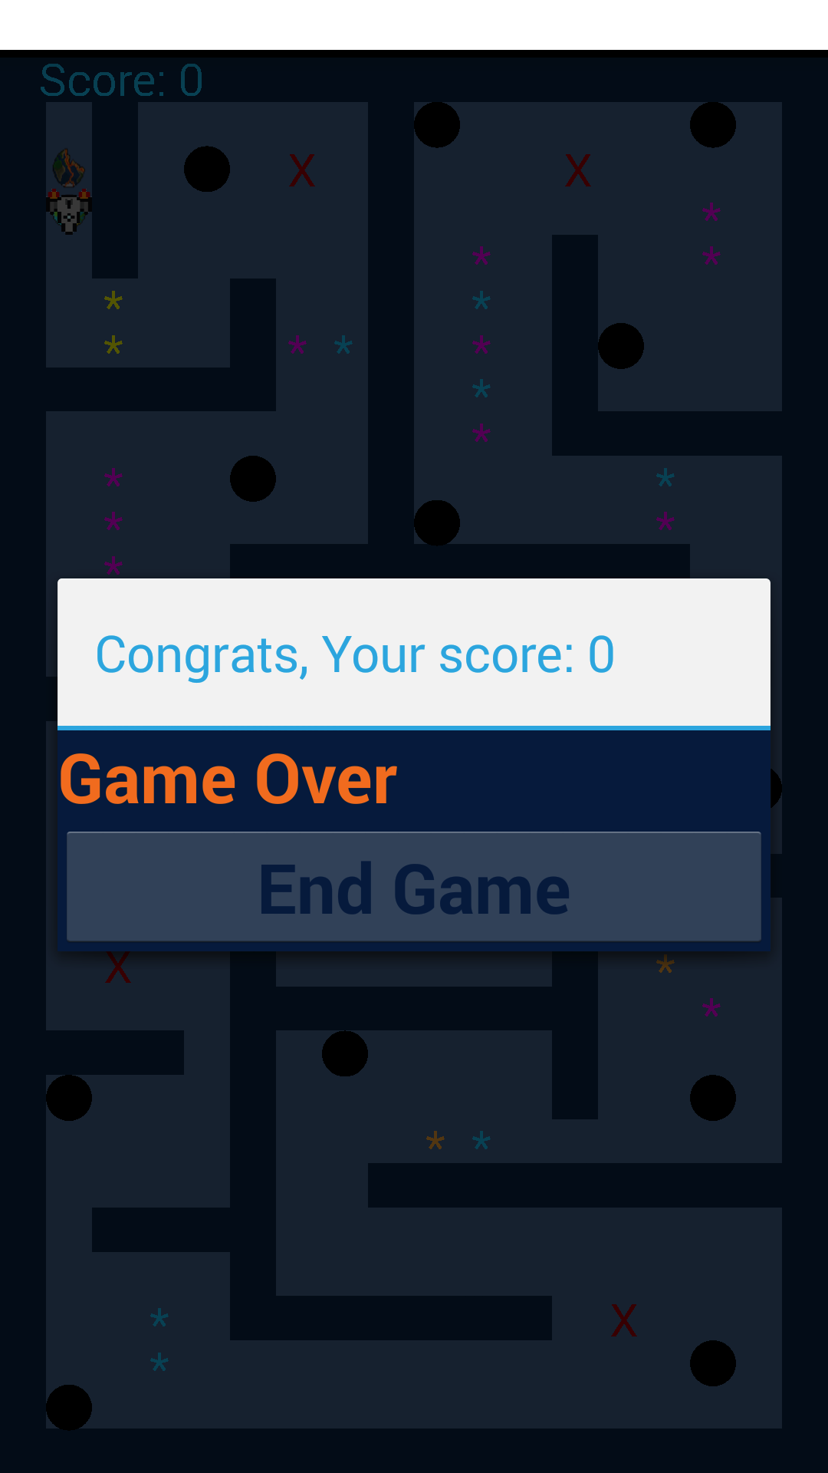
End of game pop-ups
Easily understood phrase to show the user if he wins or loses

Slide 8
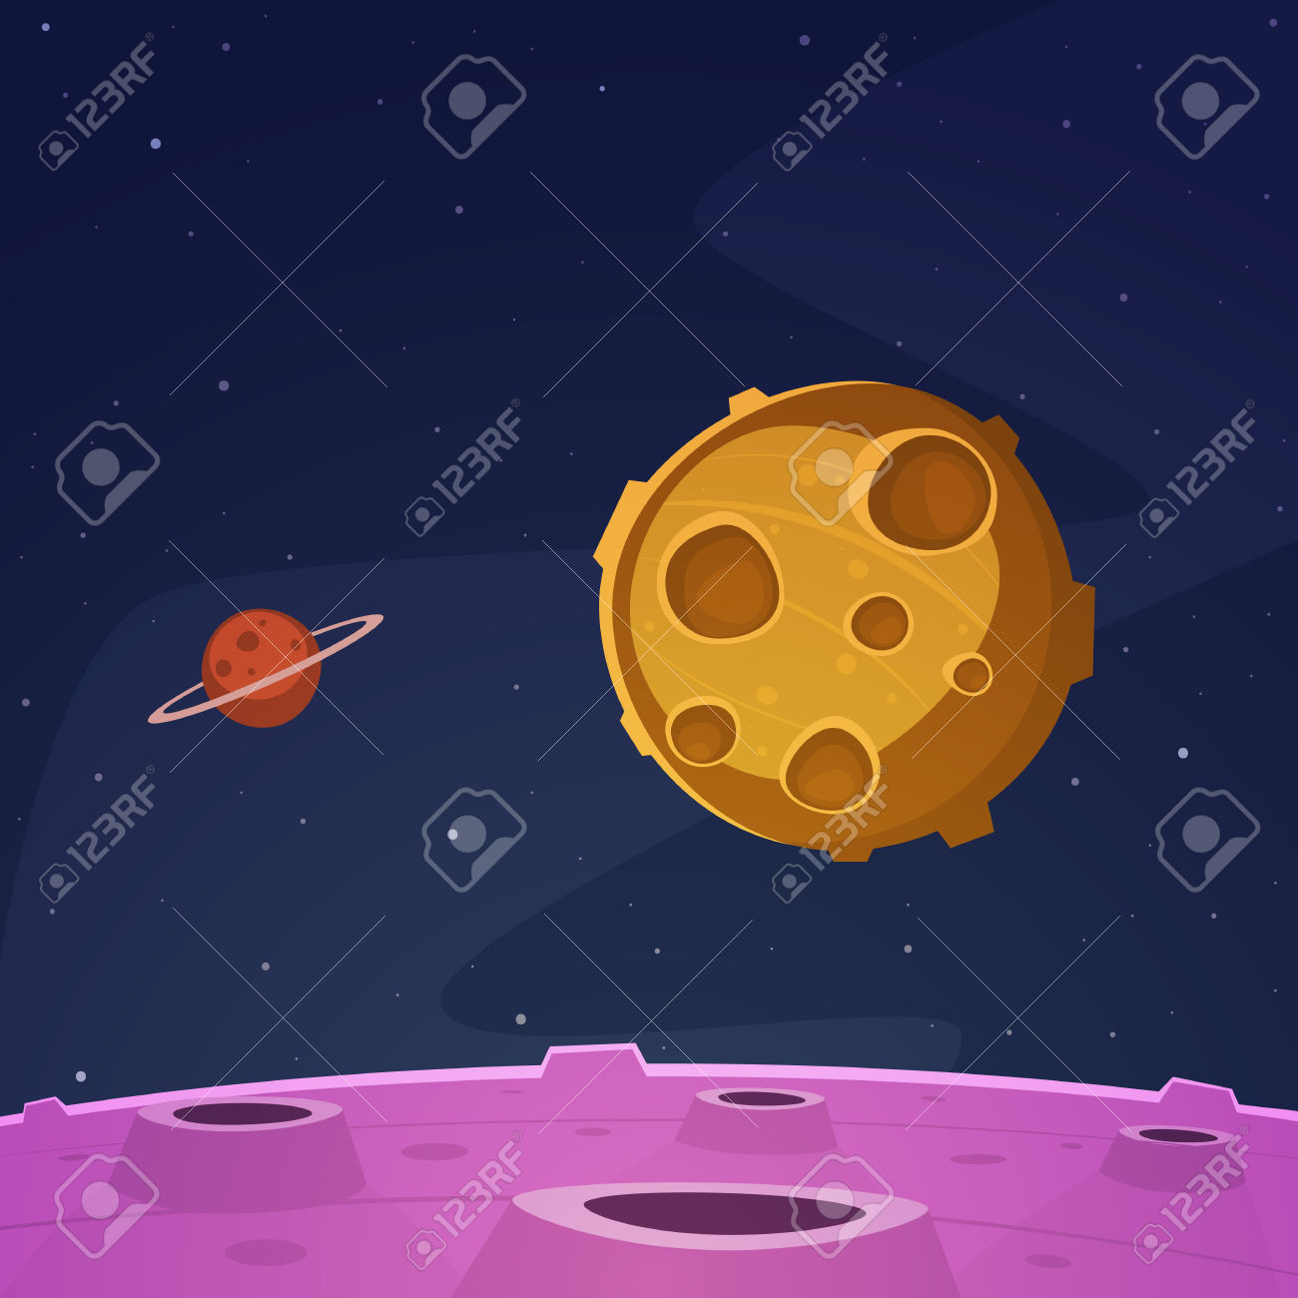
Maze
Homescreen
class
Game Logic Activity
Canvas View
Load Maze Data
Show Loading Graphic
Get Parsed Maze Data
Display Maze Data
Redraw the Spaceship Image
Wait for user input
User tilts phone
Recalculate new coordinates
Shows score increase or death
Determines effects of obstacles

Slide 9
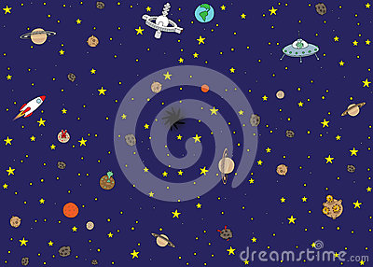
Thank You
Download
and enjoy the game

